Slide 1


Slide 2
More Low Level C
Welcome To The Machine

Slide 3
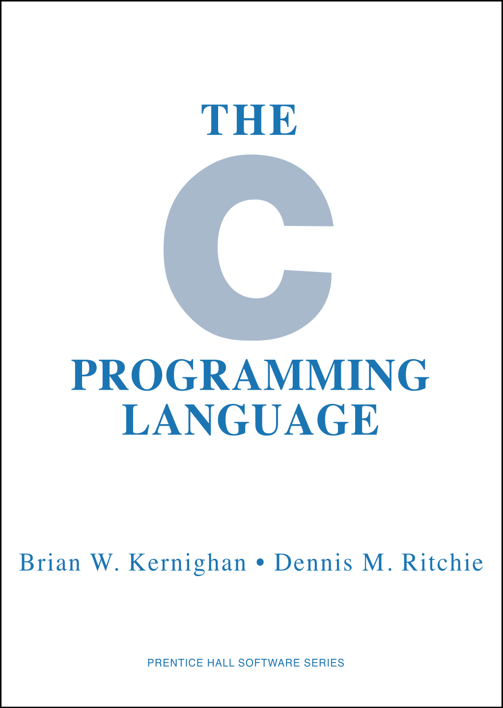
Last Lecture
In the last two lectures, we’ve been looking at relatively low level C
Again, to program in C well it is necessary to have a good mental model for how a computer works
A major goal of this class is to give you that model
Notes:
Can be found online… but I can’t link to it

Slide 4
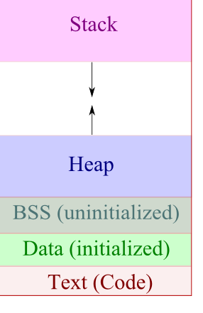
Review
Remember, in C, memory is effectively treated like a huge byte array
That memory is divided up into segments
Each segment has its own quirks and behaviors
Notes:
Can be found online… but I can’t link to it

Slide 5
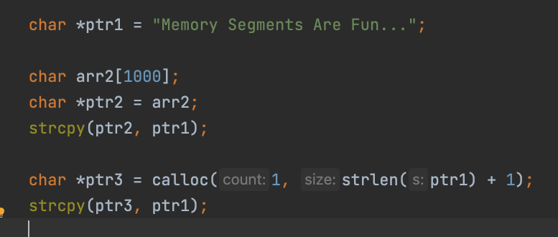
Review
Consider the following code
Where does
ptr1 point to?
ptr2 point to?
ptr3 point to?
What does assigning arr2 to ptr2 do?
Notes:
Can be found online… but I can’t link to it

Slide 6
Review
Understanding which memory segment each of these pointers ends up pointing to and how that memory segment behaves is important for developing a good understanding of C
And for getting a good grade on the next quiz :)
Notes:
Can be found online… but I can’t link to it

Slide 7
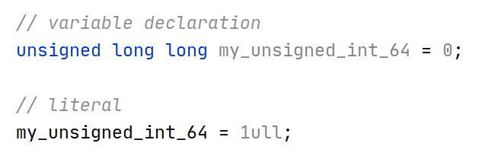
Bit Manipulation
Again, C is very low level and you can treat nearly anything as just an array of bytes
Recall 1 byte is 8 bits
C also allows you to manipulate individual bits in memory via bitwise operators
Notes:
Can be found online… but I can’t link to it

Slide 8
Bit Manipulation
Why on earth would you want to manipulate individual bits in memory?
What if you needed to store a bunch of booleans?
How many bits does a boolean take up, in theory?
Notes:
Can be found online… but I can’t link to it

Slide 9
Bit Manipulation
You can efficiently store up to 64 booleans in a single long long (64-bit) integer!
Much more memory efficient than, say, 64 32-bit integers!
These sorts of things matter in embedded programming, etc.
Notes:
Can be found online… but I can’t link to it

Slide 10
Bit Manipulation
Bit manipulation is based on simple boolean logic, where 1 is true and 0 is false
Recall our logical operators:
NOT
AND
OR
XOR
Notes:
Can be found online… but I can’t link to it

Slide 11

Bit Manipulation
When applying a bitwise operation to a piece of data, each bit will have the given logical operation applied
So, in the case of a bitwise not, each of the bits in a given piece of data are inverted
Notes:
Can be found online… but I can’t link to it

Slide 12
Bit Manipulation
Here a single byte of data, w/ the hex value 0x2A (42) is inverted using the bitwise not operator, ~
For each bit, if the bit is 0, it becomes 1 if it is 1 it becomes 0
The resulting value is 0xD5 (213)
Notes:
Can be found online… but I can’t link to it

Slide 13
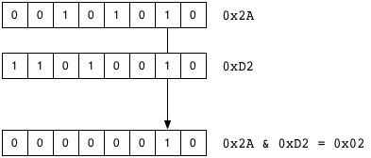
Bit Manipulation
Another common bitwise operator is the bitwise AND, which uses a single ampersand (as opposed to the logical AND, which uses two ampersands)
Unlike the bitwise not, which is a unary operator, this is a binary operator
Notes:
Can be found online… but I can’t link to it

Slide 14
Bit Manipulation
For each bit in both pieces of data, if both bits are 1, set the resulting bit to 1, otherwise set to 0
Here the two pieces of data only have only one bit where both are set to 1, so the resulting data has only one bit set to 1 (giving the decimal value 2)
Notes:
Can be found online… but I can’t link to it

Slide 15
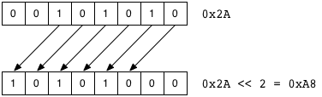
Bit Manipulation
Finally, there is one more important bit manipulation that doesn’t involve traditional logic: shifting
Shifting moves bits to the left or to the right some number of times
Notes:
Can be found online… but I can’t link to it

Slide 16
Bit Manipulation
Here we have a left shift being applied using the left shift operator, <<
The shift operator takes a right hand argument that indicates how many bits to shift over
In this case, we are shifting everything over two bits
Notes:
Can be found online… but I can’t link to it

Slide 17
Bit Manipulation
Recall that we saw that the gcc MIPS compiler emitted a shift operator for a multiplication
Again, this is because, in binary, a left shift is a multiplication by 2
Just like in base 10, a left shift is a multiplication by 10
Notes:
Can be found online… but I can’t link to it

Slide 18
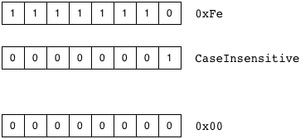
Bit Manipulation
OK, so how is this all used to store individual booleans in larger data types?
Let’s store 8 booleans in a single byte
Let’s let the first bit indicate if a piece of data is Case Insensitive
How can we manipulate it?
Notes:
Can be found online… but I can’t link to it

Slide 19
Bit Manipulation
The first step is to define a constant in C, CaseInsensitive, that has the left hand bit, and only the left hand bit, set to 1
This is the binary value 0b1 or just 1
Notes:
Can be found online… but I can’t link to it

Slide 20
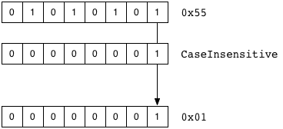
Bit Manipulation
Now, given a byte, we can test if the byte is 1 or 0 by using the bitwise AND, the bit mask, and the input byte: if(data & CaseInsensitive) { … do something }
Notes:
Can be found online… but I can’t link to it

Slide 21
Bit Manipulation
If we want to set the bit in data to 1, we can use the bitwise OR and that constant: data = data | CaseInsensitive
Notes:
Can be found online… but I can’t link to it

Slide 22
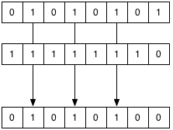
Bit Manipulation
Finally, if we want to clear the byte, we can use a bitwise AND and a bitwise NOT data = data & ~CaseInsensitive
Notes:
Can be found online… but I can’t link to it

Slide 23
Bit Manipulation
Given these three tools you can now “pack” N booleans into a datatype of size N bits
Still occasionally used even in high level programming languages like Java
See java.util.BitSet for example
Notes:
Can be found online… but I can’t link to it

Slide 24
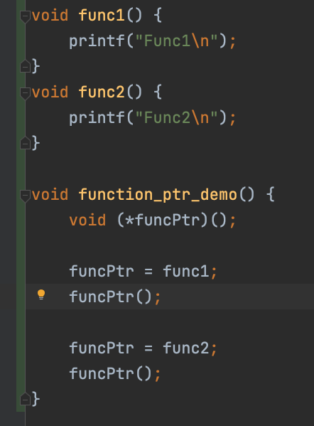
Function Pointers
C supports a notion of function pointers, that is, pointers to a given function in memory
The declaration syntax is pretty crazy:
The return type of the pointer
The name of the variable prefixed by a * enclosed in parens
The types of the function args
Notes:
Can be found online… but I can’t link to it

Slide 25
Function Pointers
In this case, this says: a pointer to a function that has a void return type and no arguments
You can see that both func1() and func2() satisfy this type signature
You can assign either to the funcPtr variable
Notes:
Can be found online… but I can’t link to it

Slide 26
Function Pointers
You can then invoke the functions by calling the funcPointer
Question: which memory segment does the funcPtr variable point to?
Notes:
Can be found online… but I can’t link to it

Slide 27
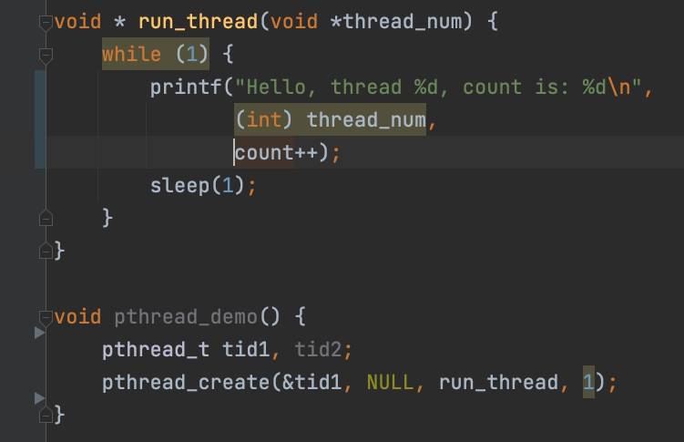
Function Pointers
Function pointers are useful in situations where you want a dynamic callback
A good example of that is the C threading library, pthreads
If you want to start a new thread of execution, you pass a function pointer into a function, pthread_create()
Notes:
Can be found online… but I can’t link to it

Slide 28
Function Pointers
Here we pass the run_thread() function into the pthread_create() function, and it will be invoked in a new thread
We are not going to look at multithreading in C beyond this, we will look at it in Java
Much better implementation IMO
Notes:
Can be found online… but I can’t link to it

Slide 29
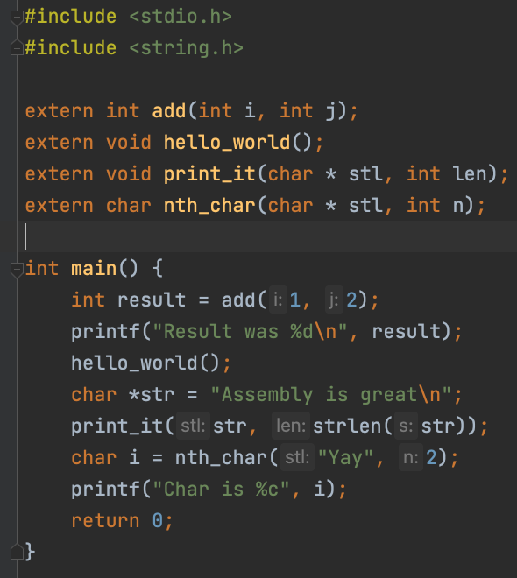
Assembly In C
Recall that C has been called “glorified assembler”
I don’t really agree with that characterization, but there is some truth to it
Notes:
Can be found online… but I can’t link to it

Slide 30
Assembly In C
There are two primary ways to interact with assembly from C
Include a reference to an assembly file
Inline assembly
Here we have a C file referring to functions defined in an assembly (asm) file
Notes:
Can be found online… but I can’t link to it

Slide 31
Assembly In C
The symbols are defined as extern, which tells the C compiler “These things are going to come from elsewhere, just assume they will be there”
Later, a linker will link up the function calls in the C with their definitions from assembly
Notes:
Can be found online… but I can’t link to it

Slide 32
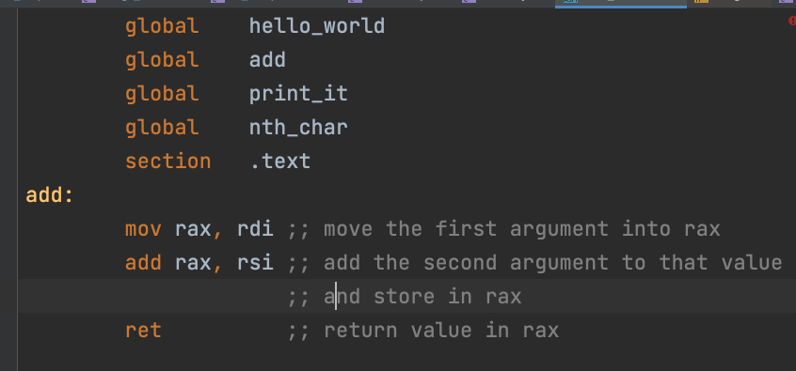
Assembly In C
Here is what the add() function in the assembly file looks like
Note that it is defined in the text segment
This label will be what is used by the linker later on in the compilation process to figure out where to jump when the add function is invoked
Notes:
Can be found online… but I can’t link to it

Slide 33
Assembly In C
Note that it is the assembler programmers responsibility to implement calling conventions properly!
Very easy to screw things up!
Notes:
Can be found online… but I can’t link to it

Slide 34
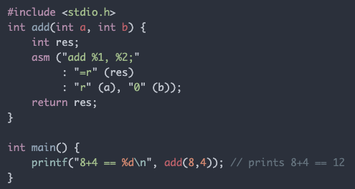
Assembly In C
Another way to invoke assembly is to use inline assembly
The specifics of inline assembly very much depend on which compiler you are using
And, obviously, what architecture you are targeting!
Notes:
Can be found online… but I can’t link to it

Slide 35
Assembly In C
At right is a gcc example that does a register-based add instruction (maybe to avoid the traffic with the stack we saw when we were looking at compiler output)
Notes:
Can be found online… but I can’t link to it

Slide 36
Assembly In C
asm (instructions : output operands : input operands : clobbers);
In this case, we have a simple add instruction
The res value is the output and is stores in a register
a & b should be stored in a register too
Notes:
Can be found online… but I can’t link to it

Slide 37
Assembly In C
Obviously a niche need, but useful at times:
Overcome “bad code generation” by a given C compiler
To invoke features on a given CPU only available through assembly
Notes:
Can be found online… but I can’t link to it

Slide 38
Review
Again, know how the various segments of memory work in C
We took a look at bitwise manipulation and, in particular, how to “pack” 8 bits into a byte of data so we could store 8 booleans in a byte
Function pointers allow you to pass functions to other functions
Useful for callback situations like when creating threads
Finally, we looked as how to integrate assembly code into C projects

